Slide 1
2
108th AGM
CHAIRMAN’S REPORT
16th May 2018

Slide 2
BACKGROUND
Established in 1909 as the East Africa Natural History Society (EANHS)
EANHS is one of Africa’s oldest scientific Societies
Nature Kenya is the BirdLife partner in Kenya
Aim – Promotion of the study of natural history and conservation of nature in Eastern Africa

Slide 3
Nature Kenya GUIDING THEMES
Membership
Local
Empowerment
Public
Awareness
MISSION:
Connecting
Nature & People for a
sustainable future
Species & Site
Conservation
Advocacy &
Policy Making
Nature Kenya
Management
Funding
Notes:
NO. OF PROJECTS 2011 - 20
EXPENDITURE 2011 - c 130 M KSh MEMBERSHIP, CONSERVATION PROJECTS

Slide 4
Nature Kenya Management
Board Members
NAME | POSITION
Dr Ian Gordon | Chairman
Dr Helida Oyieke | Vice Chairman
Ms Fleur Ng'weno | Honorary Secretary
Mr Jim Birnie | Honorary Treasurer
Dr Dino Martins | Honorary Librarian
Dr Charles Warui | Honorary Editor
Dr Siro Masinde | Member /Trustee
Ms Irene Njumbi | Member/ Trustee
Ms Wakini Ndegwa | Member/Trustee
Notes:
Ms Wakini Ndegwa Member/Trustee

Slide 5
Cont’ Board members
NAME | POSITION
Dr. Geoffrey Mwachala | Member
Kuria Waithaka | Member
Ms Fleur Ng'weno | Honorary Secretary
Mr Upin Vasani | Member
Mr Ben Allen | Member
Dr Leon Bennun | Co-opted Member
Dr Benny Bytebier | Co-opted Member
Dr Alan Carles | Co-opted Member
Dr Darcy Ogada | Co-opted Member
Dr Evans Mwangi | Co-opted Member
Ms Heather Elkins | Co-opted Member
Mr. Rupert Watson | Co-opted Member

Slide 6
Nature Kenya Management staff
NAME | POSITION HELD
DR. Paul Matiku | Executive Director
Mr. Denvas Gekonde | Finance Manager
MS. Serah Munguti | Advocacy Manager
Ms. Gloria Waswa | Membership Manager
Mr. Paul Gacheru | Species and Sites Manager
Mr . Joel Siele | Local Empowerement Manager
Ms. Carol Kabilu | Programme Support Manager

Slide 7
2015-2020 Strategic Pillars
Save Species
Protect Sites and Habitats
Encourage Ecological Sustainability
Empower People to Support Nature

Slide 8
CONSERVATION CHALLENGES IN 2017/18
Politics
Threats to Species
Policy failures
MISSION:
Connecting
Nature & People for a
sustainable future
Limited Knowledge
Infrastruc-ture
Limited Funding
Limited public support
Limited capacity

Slide 9
OVERARCHING RESPONSES 2017/18
Policy
Local Support
Advocacy
Restoration & land purchase
Private Sector
MISSION:
Connecting
Nature & People for a
sustainable future
Science
Constitue-ncy
Funding
Education
Partnership

Slide 10
PILLAR 1. SAVE SPECIES
1.1 Prevent Extinctions
Poisoning Response Protocol
Indian House Crow Control
Taita Apalis in Taita Hills
Clarkes Weaver in Dakatcha

Slide 11
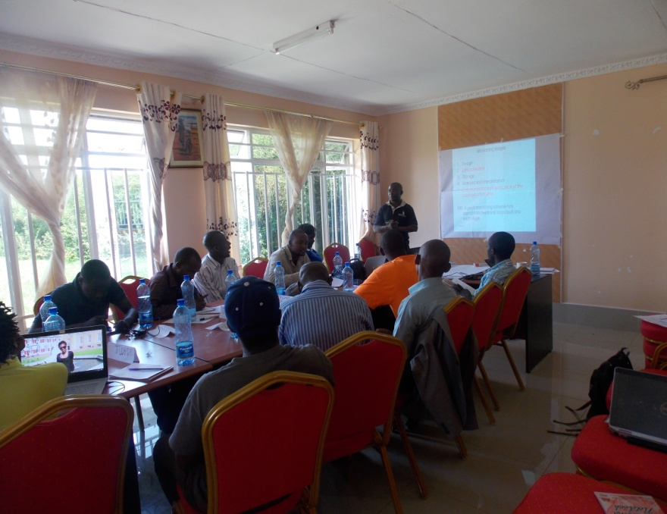
PILLAR 1. SAVE SPECIES
1.2 Keep Common Birds Common
Detailed Species Monitoring - 15 sites
Integrated mainstreaming IBA conservation strategy into county development plans - 7 counties

Slide 12
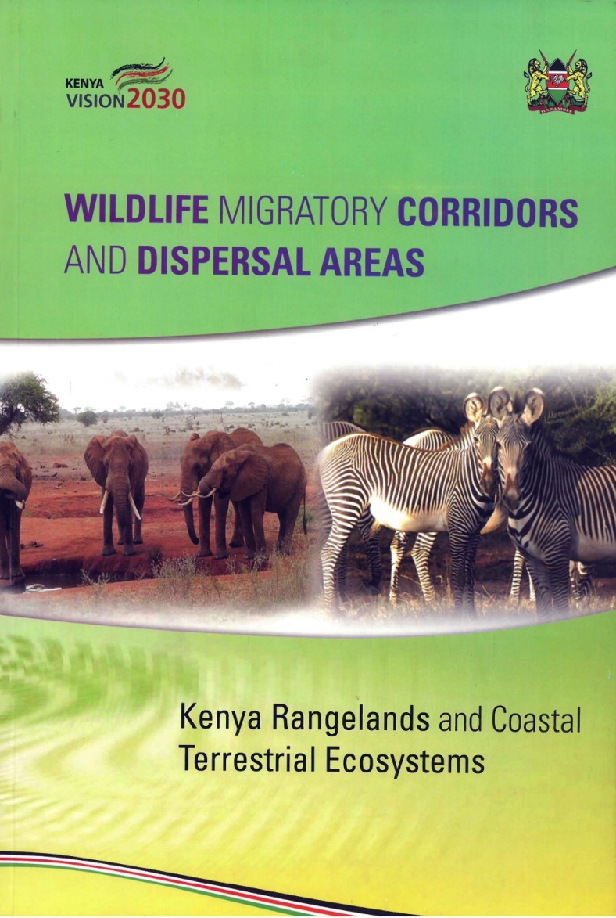
PILLAR 2. CONSERVE SITES AND HABITATS
2.1 Create Effective Ecological Networks
Arabuko-Sokoke Forest elephant corridor
Purchasing 8 acres in Taita for Critically endangered Taita Apalis
Piloting habitat restoration in Taita hills forests

Slide 13
PILLAR 2. CONSERVE SITES AND HABITATS
2.2 Site Identification and Monitoring
Monitoring results 2017
State: still unfavorable
Pressure: Increased
Response: reduced

Slide 14
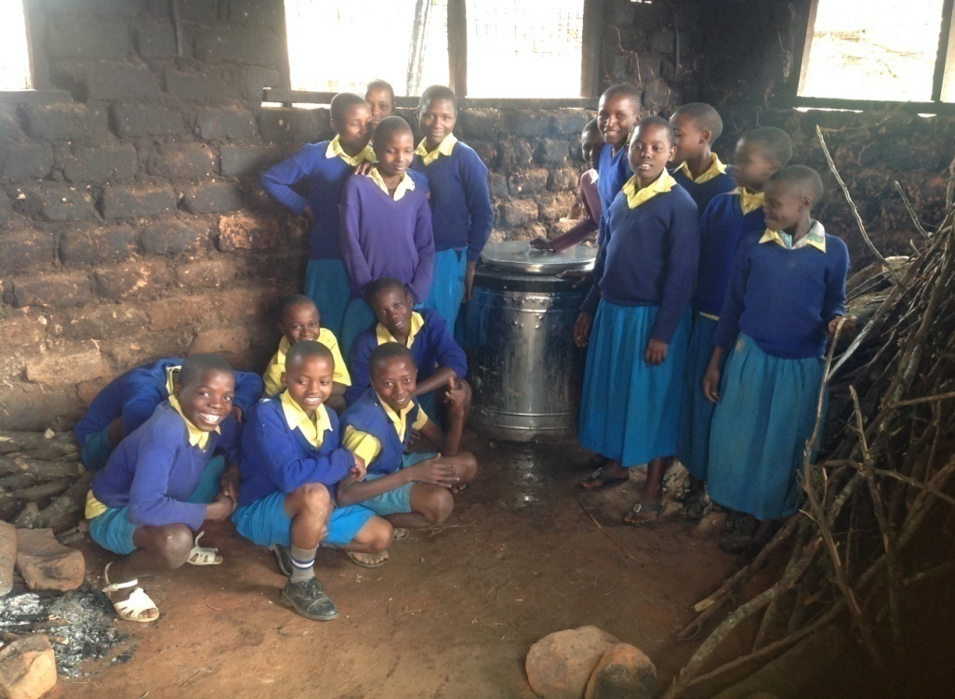
PILLAR 2. CONSERVE SITES AND HABITATS
2.3 Promote Restoration of Degraded Habitat
Ecosystem Services Assessment in Tana Delta
Clean cook stoves installed in 16 schools
Linked 5 CFAs from Mt. Kenya with private sector
747,000 seedlings planted by 14 CFAs/25 SSGs
A display of energy cooking stove at a school in Taita

Slide 15
PILLAR 3. ENCOURAGE ECOLOGICAL
SUSTAINABILITY
3.1 Key achievements
Promoted Policies, legislation and institutional frameworks for ecosystem resilience
Promoted safeguards for nature through review of EIAs/SEAs
Promoted conservation of landscapes through Land Use Planning
Promoted sustainable production e.g. Kipeto Wind energy
Engaged private sector in restoration e.g. Mt Kenya
Promoted engagement of site support groups in policy processes

Slide 16
PILLAR 3. ENCOURAGE ECOLOGICAL
SUSTAINABILITY
3.2 Engaged in policy and legislative processes at county, national and global levels
Comments for 12 EIA/SEA reports submitted to NEMA
4 memoranda submitted to the National Assembly
Submitted memorandum to the National Taskforce on Forest Management and Logging Activities in Kenya
Submitted inputs to 6 County Integrated Development Plans
Nature Kenya represented in Key National Committees and Fora
Submitted comments on the new Environmental (Strategic Assessment, Integrated Impact Assessment and Audit) Regulations

Slide 17
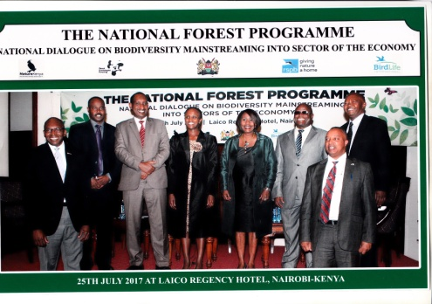
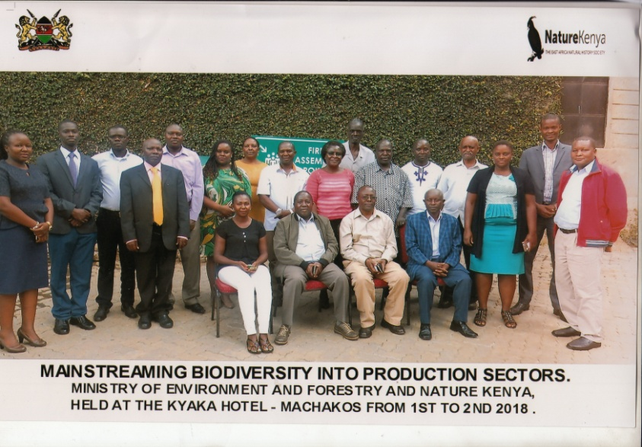
PILLAR 3. ENCOURAGE ECOLOGICAL
SUSTAINABILITY
3.2 Engaged in policy and legislative processes at county, national and global levels
Advocacy strategy on mainstreaming biodiversity
Convened a national dialogue on mainstreaming biodiversity
Supported Mo Eto convene a national workshop to review progress towards implementation of CBD
1 policy brief submitted on wildlife policy
National dialogue on biodiversity mainstreaming
Review workshop on mainstreaming
biodiversity into production sectors at Machakos

Slide 18
PILLAR 3. ENCOURAGE ECOLOGICAL
SUSTAINABILITY
3.3 Business engagement in sustainable production
Kipeto wind farm for Critically Endangered Rüppells and White-backed Vultures
IFC Performance Standard 6 agreed for net gain for critically vultures and allocated $ 1million per year to fund biodiversity offsets
Engaged USAID to fund a national Strategic Environmental Assessment on Wind Farms placement,

Slide 19
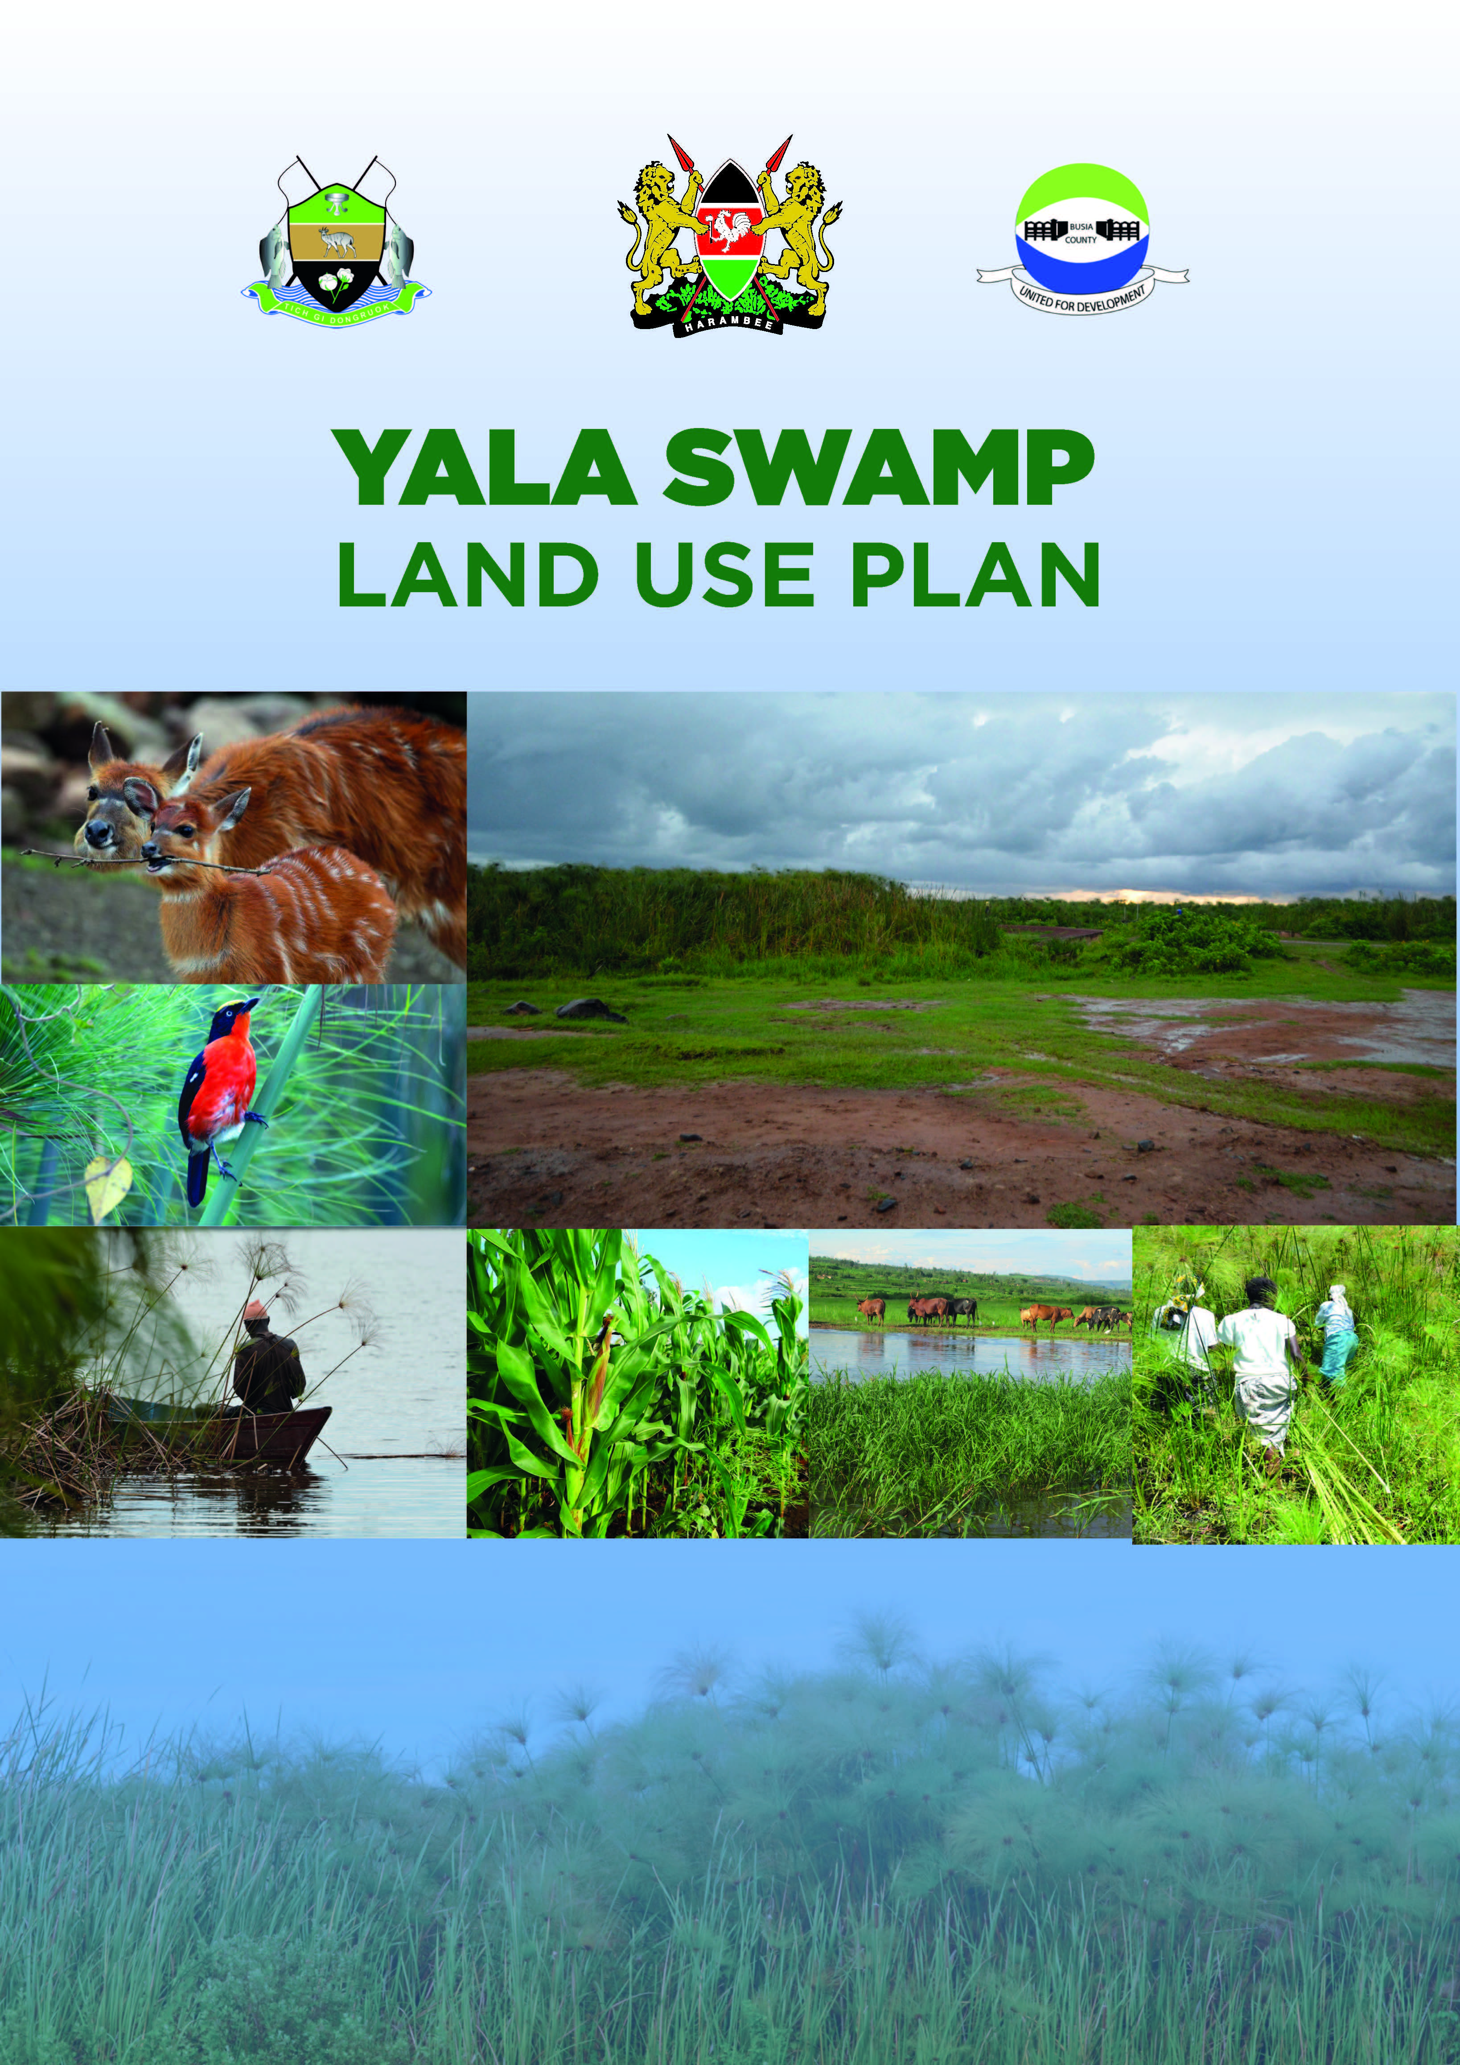
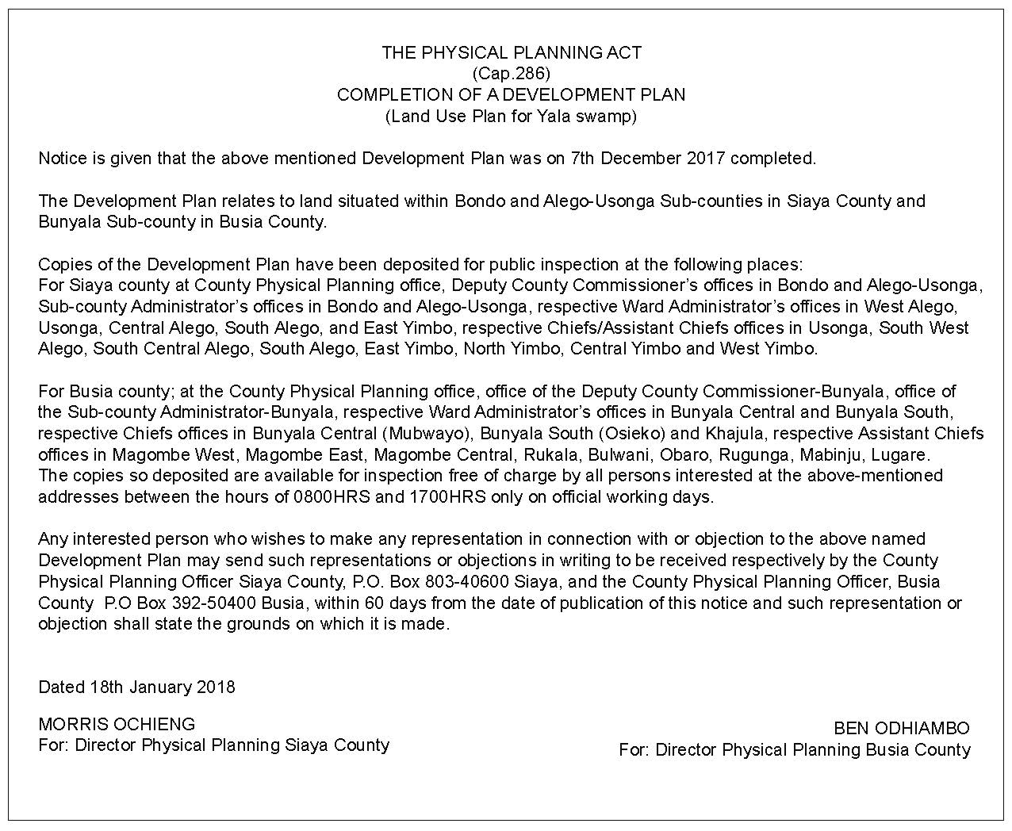
PILLAR 3. ENCOURAGE ECOLOGICAL
SUSTAINABILITY
3.4 Promotion of conservation of landscapes
Implementation of Tana River Delta Land Use Plan (LUP) and Strategic Environmental Assessment (SEA)
Drafting of a LUP bill for Lamu County Successfully engaged Tana River & Siaya Counties to recognize LUP in CIDP
Yala Swamp LUP and SEA completed

Slide 20
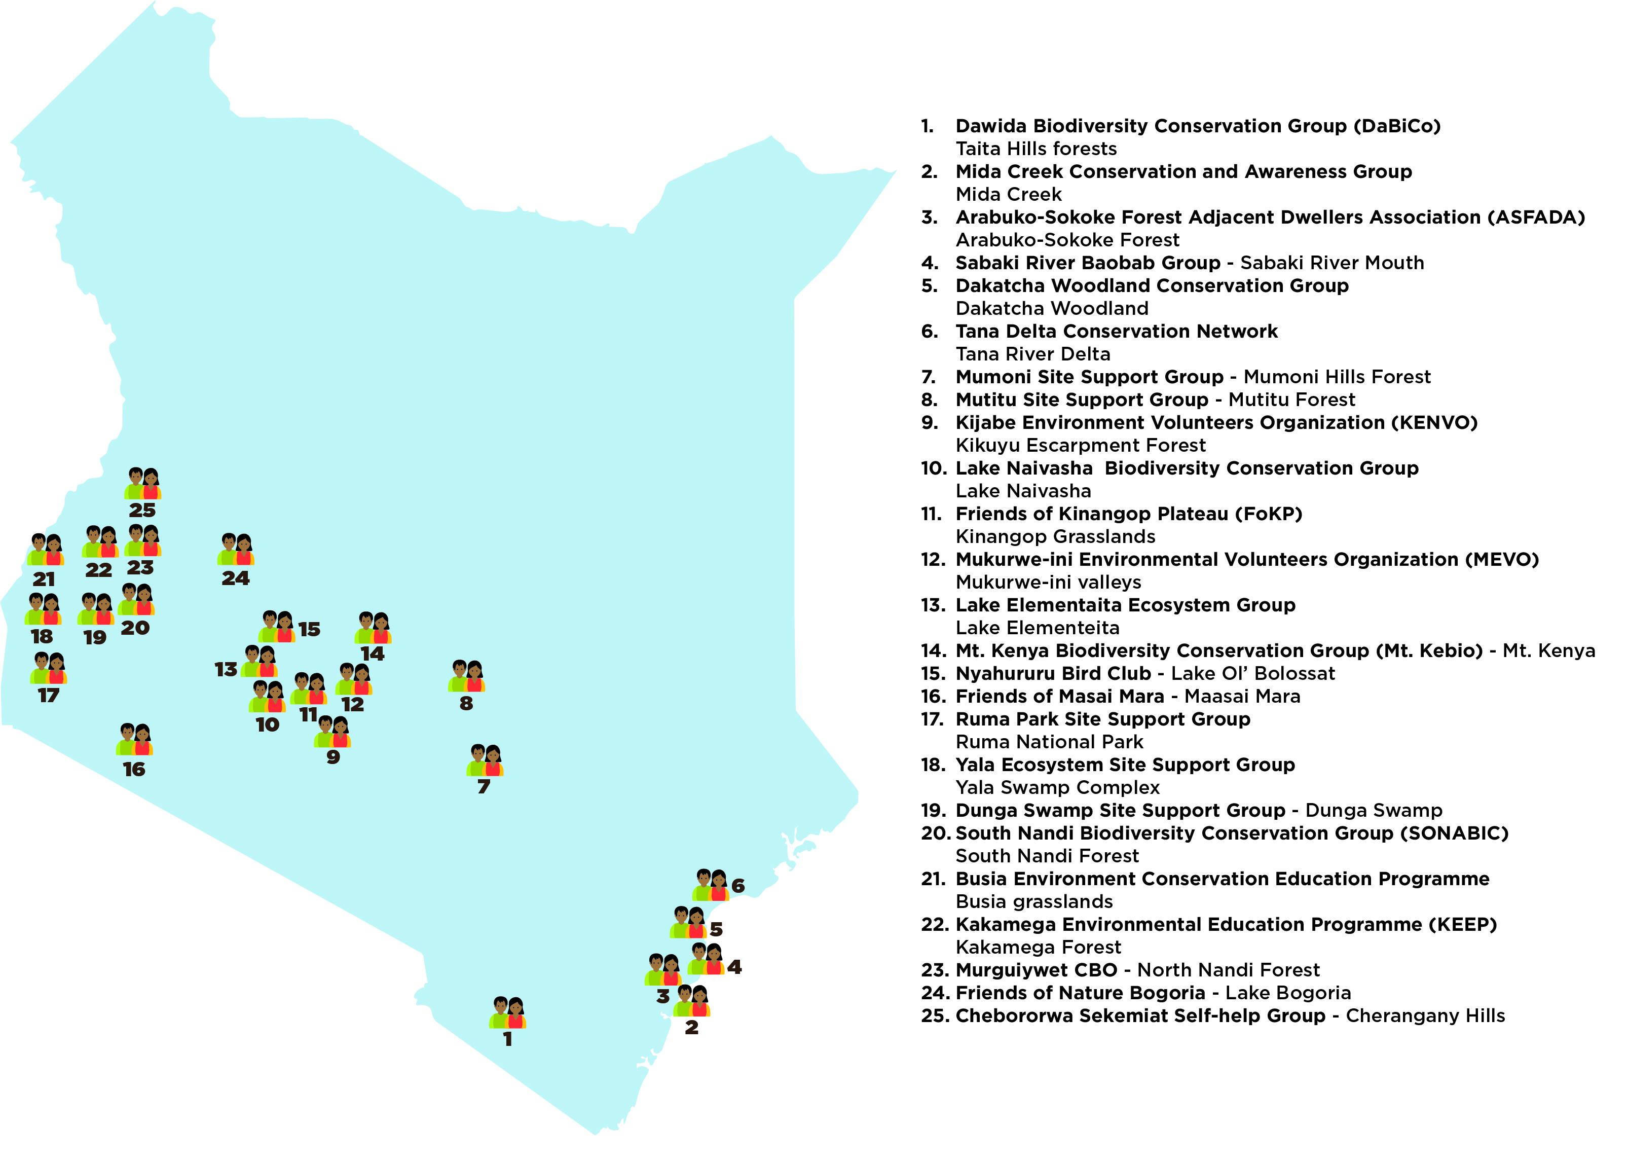
4. EMPOWER PEOPLE TO
SUPPORT NATURE
Site Support Groups (SSGs) distribution Map

Slide 21
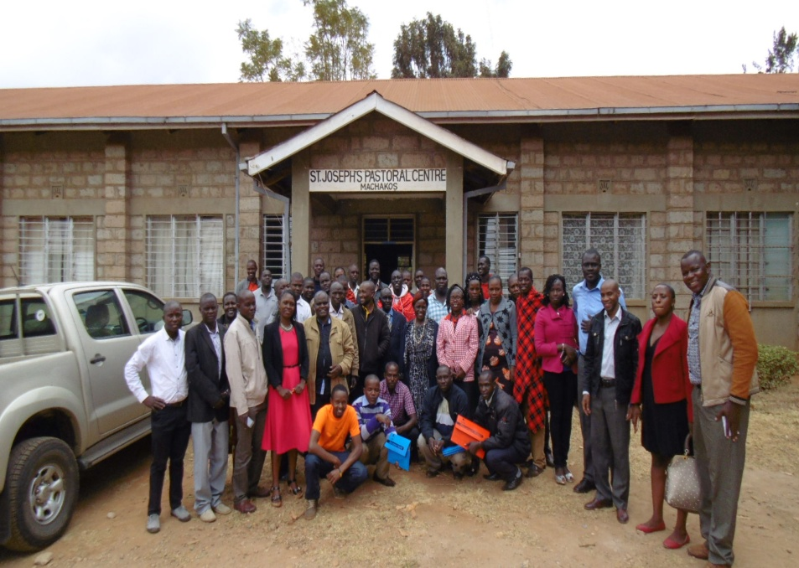
4. EMPOWER PEOPLE TO
SUPPORT NATURE
Capacity Building
5 CFAs in Mt. Kenya developed action plans and business cases which was presented to water buyers and other stakeholders to support restoration of Mt. Kenya
21 SSGs (42 participants; 11 women and 31 men) trained, shared experiences during national SSG workshop 2017
15 SSGs members from Taita hills & Dakatcha Woodland trained on apiculture techniques at Baraka Training Institute in Molo, Nakuru County.
4 SSGs from Kilifi County trained on Advocacy and resource mobilization
5 SSG Members (2-Yala, 1-Taita, 1-Dakatcha & 1-Arabuko) trained on Fundamentals of Ornithology (FoO)
Representatives of 21 Site Support Groups during National SSG Workshop 2017. Photo: by J. Siele

Slide 22
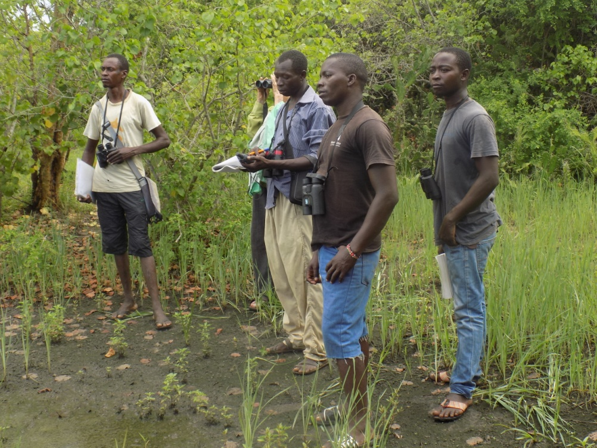
4. EMPOWER PEOPLE TO
SUPPORT NATURE
Build Grassroots Capacity and Networks for Nature Conservation
Local Monitoring and action
SSGs are carrying out detailed monitoring at 6 sites (Kakamega, Taita, Dakatcha, Arabuko, Yala, Dunga)
23 SSGs are involved in Common Bird Monitoring
9 SSGs involved county decision making processes
7 SSGs implementing advocacy strategies
15 SSGs have signed partnership agreements with Nature Kenya
Biodiversity monitoring at Arabuko Sokoke Forest

Slide 23
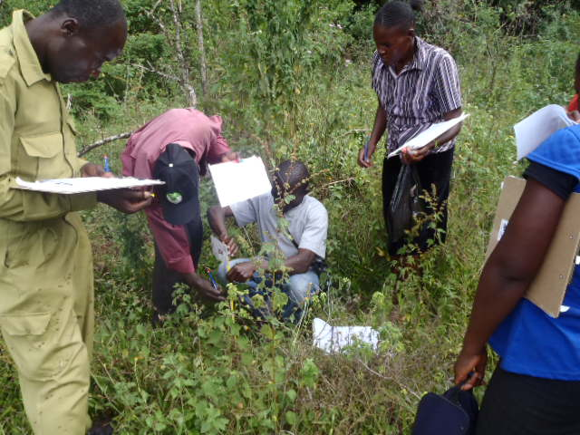
4. EMPOWER PEOPLE TO
SUPPORT NATURE
Build Grassroots Capacity and Networks for Nature Conservation
Local Monitoring and action
11 SSGs engaged government in their site activities and advocacy (Dunga, Yala, Arabuko, Taita, Tana, Mt.Kenya, Bogoria, Cherangani, Kinangop, Naivasha, Dakatcha)
26 CFAs from 6 forest IBAs are implementing Forest Management Plans (9 CFAs at the coast (Taita=5, Arabuko 3 and Dakatcha1) and 5 CFAs in Mt Kenya, 3 in Nandi, 4 in Kakamega, Cherangani 6 CFAs)
9 SSGs have active environment education programmes
SSG and CFA members engaged in monitoring growth of young seedlings

Slide 24
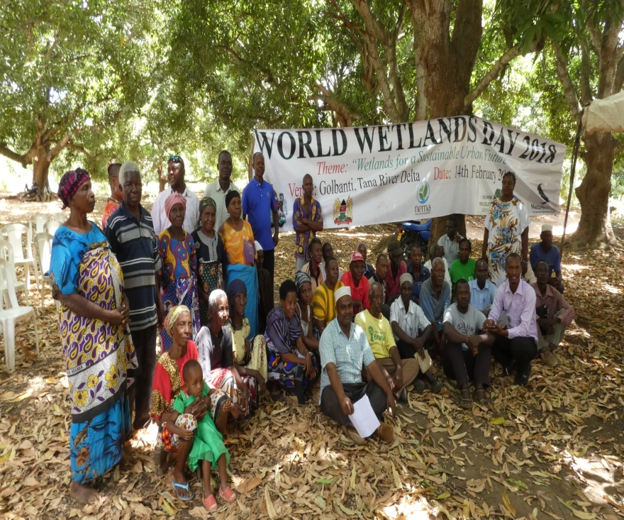
4. EMPOWER PEOPLE TO
SUPPORT NATURE
Build Grassroots Capacity and Networks for Nature Conservation
Established 2 new Site Support Groups (Ol’Bolossat & Elementaita )—now total 25 SSGs
Increased SSGs membership base to 8,638 (Males-3,625 & Females - 5,013)
24,000 adults & 47,000 students reached during World Environment Day, World Migratory Bird Day, World Wildlife Day, International Day of Forests, school/community outreach programme in 2017
County forums including SSGs convened (Taita, Busia, Siaya, Kilifi)
Public awareness during World Wetland Day 2018 Celebration in Tana Delta. Photo: by George Odera

Slide 25
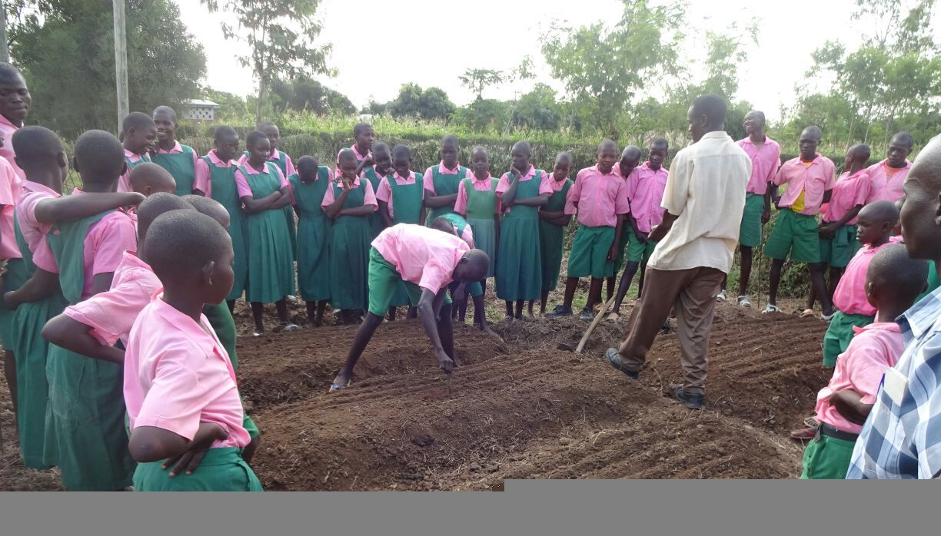
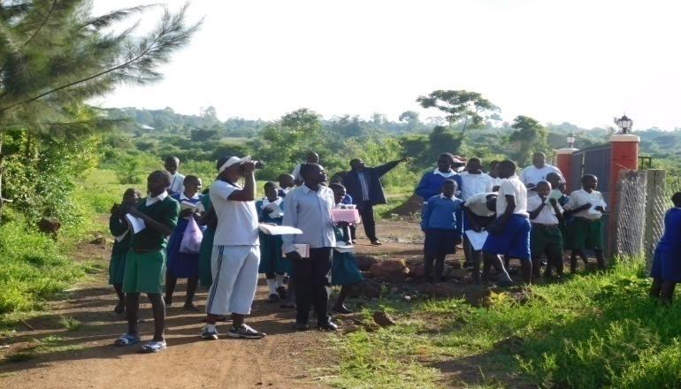
4. EMPOWER PEOPLE TO
SUPPORT NATURE
Educate young people about nature
33,240 school children visited 9 resource centres across the country where they learned on the biodiversity in the IBAs where resource centres are situated
Wildlife Clubs of Kenya (WCK) in collaboration with Nature Kenya created awareness of Taita Apalis reaching a total of 419 students and 19 teachers
School environmental outreach programme, teaching school children how to prepare tree nursery in South Nandi Photo: Sonabic
School children guided during bird watching in Yala swamp.Photo:E.Mateche

Slide 26
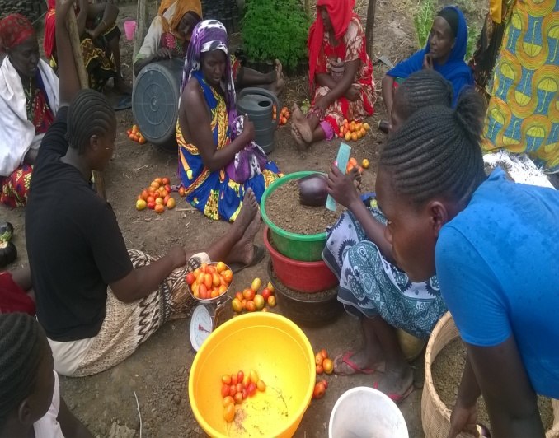
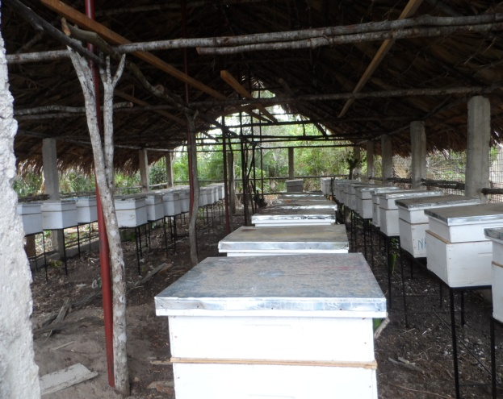
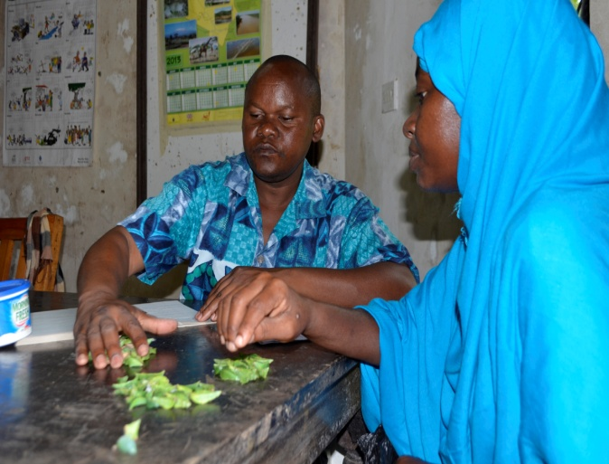
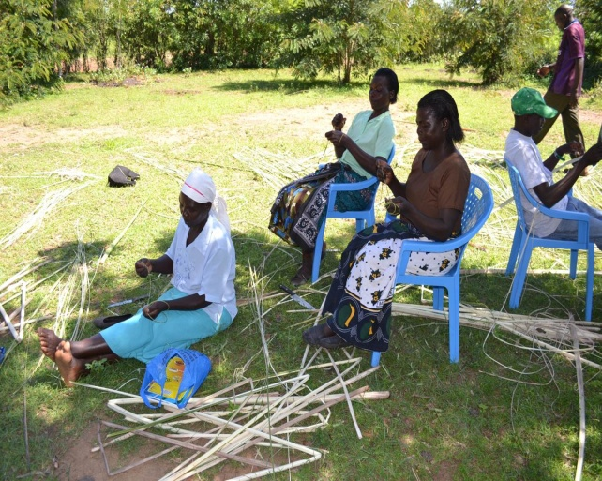
4. EMPOWER PEOPLE TO
SUPPORT NATURE
Livelihood Improvement
Household income of SSG Members increased by an average of 25% in the 2017
Hewani apiary
- G. Odera
Bidii Women Group in Moa with assorted vegetables from their kitchen garden
- G. Odera.
Kipepeo
Papyrus
development

Slide 27
4. EMPOWER PEOPLE TO SUPPORT NATURE
EARNINGS by the SSGs from selected Nature Based Enterprises (NBEs) & IGAs
Livelihoods | Earnings (Ksh) 2016 | Earnings 2017 | % increase /decrease
Bee keeping (18 SSGs) | 6,109,100 | 8,407,600 | 37.6
Butterfly farming (Arabuko, Taita & Kakamega) | 12,400,000 | 15,780,000 | 27.3
Ecotourism (Arabuko, Mida, Dakatcha, Kakamega, Dunga, Mt Kenya) | 13,846,652 | 16,325,100 | 17.9
Tree seedlings (12 SSGs) | 14,977,070 | 18,503,000 | 23.5
Wool spinning products (FoKP) | 965,490 | 1,240,860 | 28.5
Papyrus products (Yala SSG) | 116,400 | 158,650 | 36.3
Fish farming (Yala, Taita, Dunga) | 666,500 | 824,450 | 23.7
Table Banking (money in circulation) | 50,000 | 120,000 | 140.0
Totals | 49,131,212 | 61,359,660 | 24.9

Slide 28
4. EMPOWER PEOPLE TO
SUPPORT NATURE
Build Constituency and Membership
Base for Nature Kenya
Corporate members 31, individual members – 988
Retained 781 members
207 new members and 6 corporates joined Nature Kenya, (April 2017-March 2018)

Slide 29
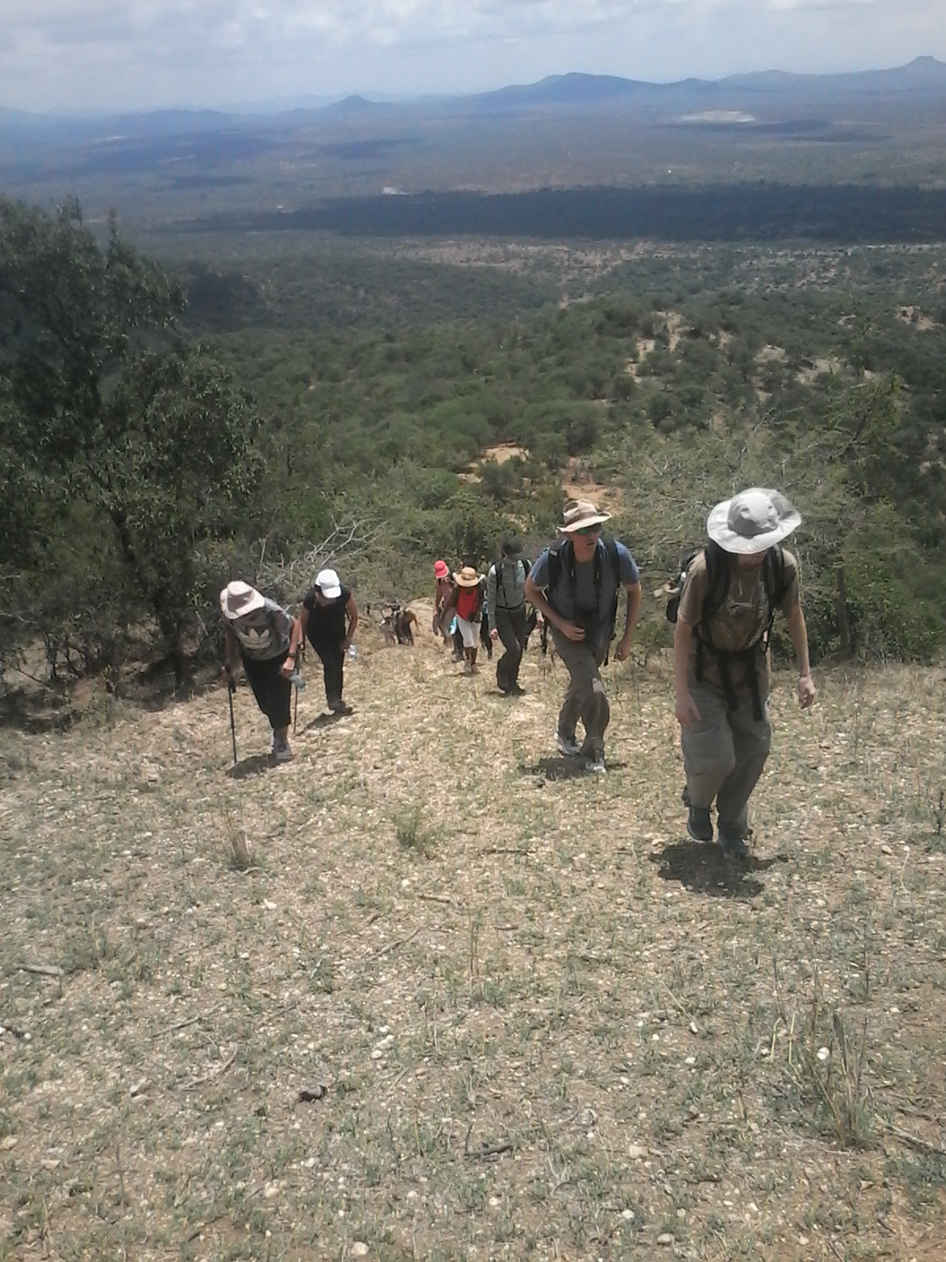
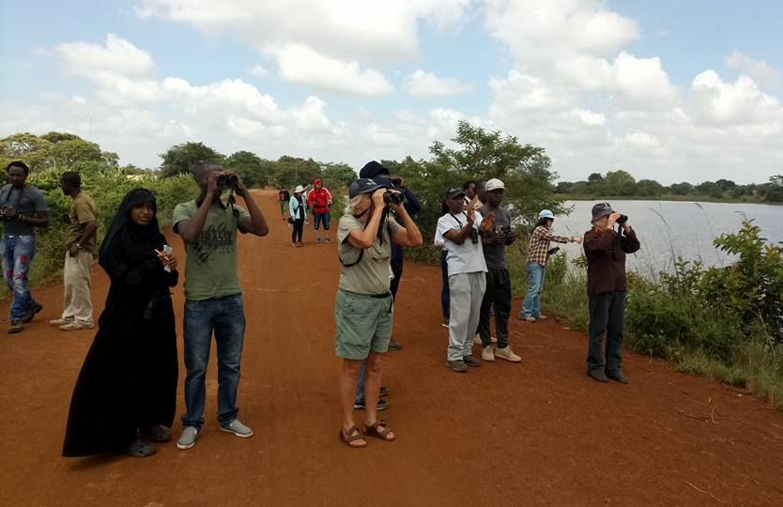
4. EMPOWER PEOPLE TO SUPPORT NATURE
Build Constituency and Membership Base for Nature Kenya
Membership events
1 AGM held in May 2017:
154 members attended
67 apologies recorded.
52 Wednesday morning bird walks held
12 potluck Sunday outings organised
2 members trips held successfully, 37members participated

Slide 30
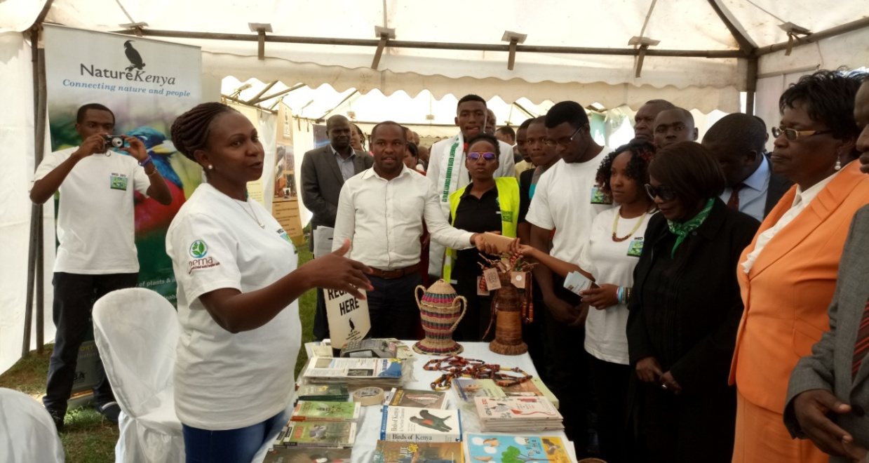
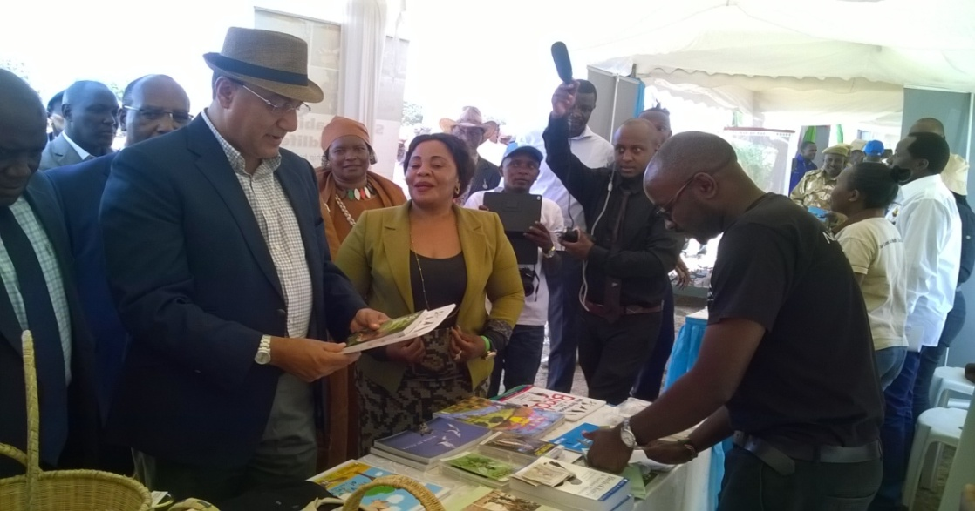
4. EMPOWER PEOPLE TO SUPPORT NATURE
Build Constituency and Membership Base for Nature Kenya
Membership drives
9 exhibitions and member recruitment drives held, 32 new members recruited
Nairobi International Trade Fair
AETFAT 2017 Congress 15
World Environment Day
World Wetlands Day

Slide 31
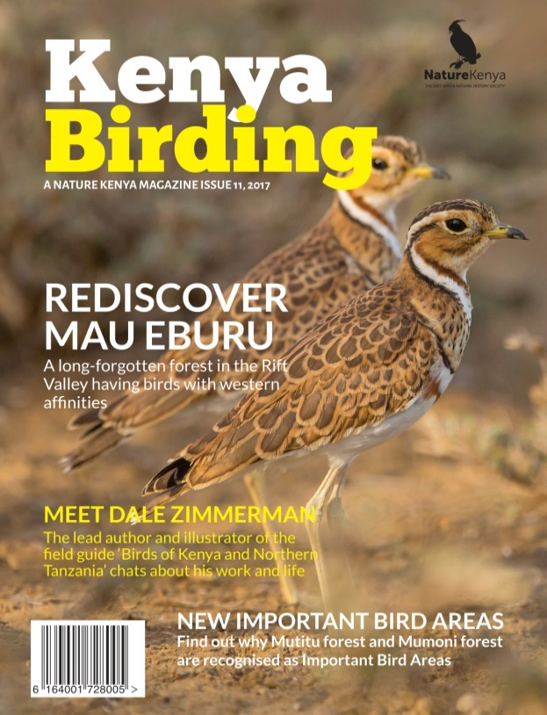
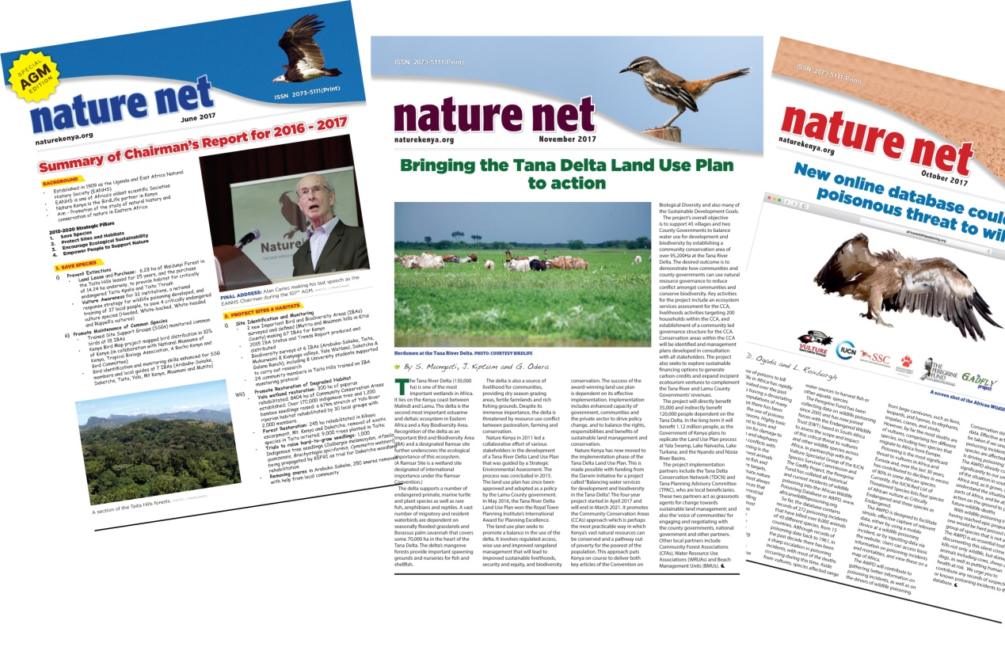
4. EMPOWER PEOPLE TO SUPPORT NATURE
Communication
Members updated by 11 issues of nature nets & 1 issue of Kenya Birding magazine via email and by post
Regular updates posted on NK’s websites facebook and twitter accounts with a total of 12000 followers
New website and We are now active available on instagram.

Slide 32
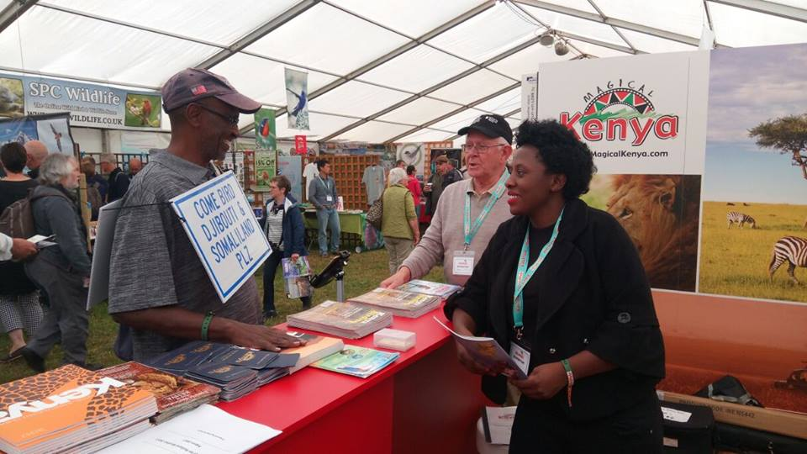
4. EMPOWER PEOPLE TO SUPPORT NATURE
Kenya birding and UK birdfair participation
Produced Kenya birding Issue 11 (2017) and distributed to members and in UK bird fair to market Kenya as a birding destination
Participated in the UK birdfair in August 2017 KTB supported the printing and exhibition in the UK Bird fair
Fundraise through advertisements on Kenya Birding magazine; 12 corporates featured on
the magazine through advertising

Slide 33
Golf Tournament -23rd March 2018
4. EMPOWER PEOPLE TO SUPPORT NATURE
The tournament aims to raise funds to restore water services provided by Mt Kenya forest.
124 players participated in the event
17 holes booked and sponsored by corporate
23 corporate engagements though sponsorships and gifts support
Received 5 in kind donations from individual

Slide 34
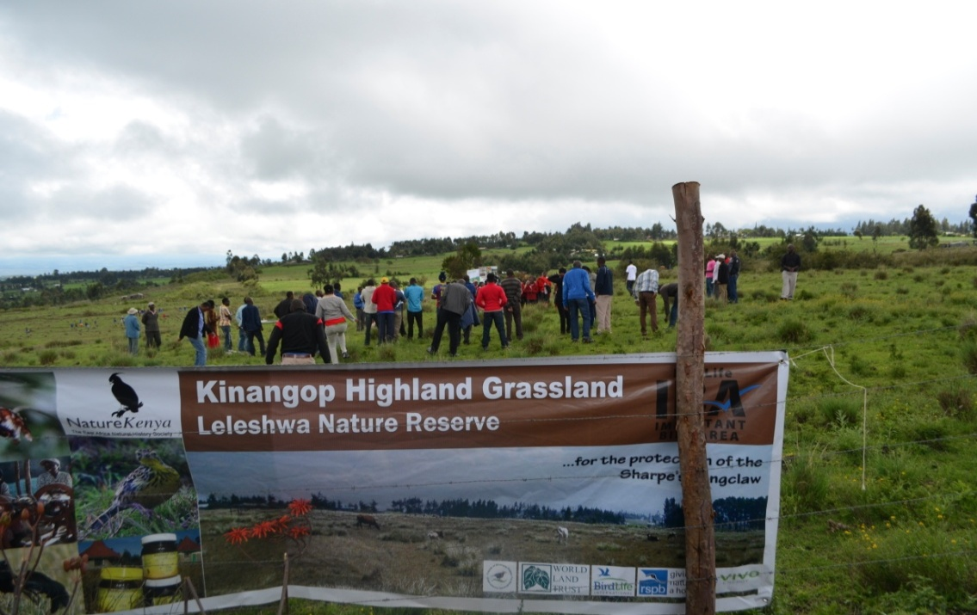
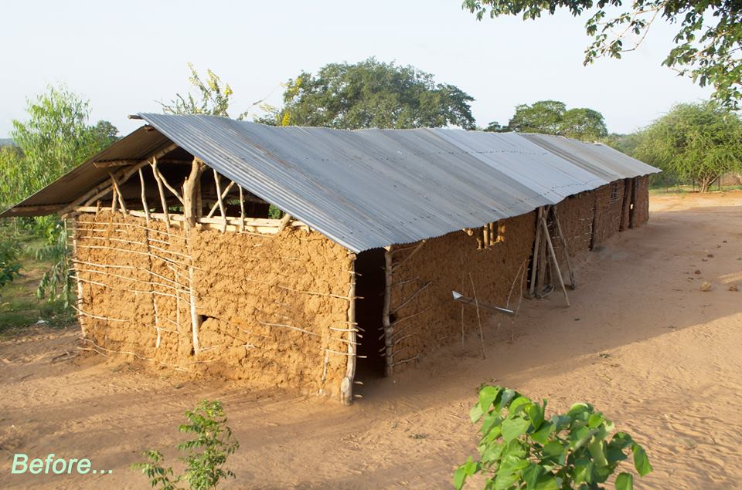
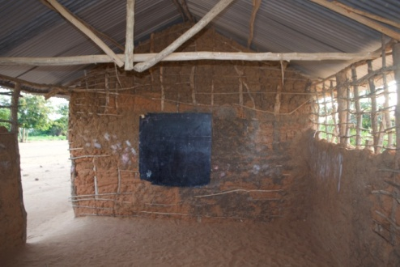
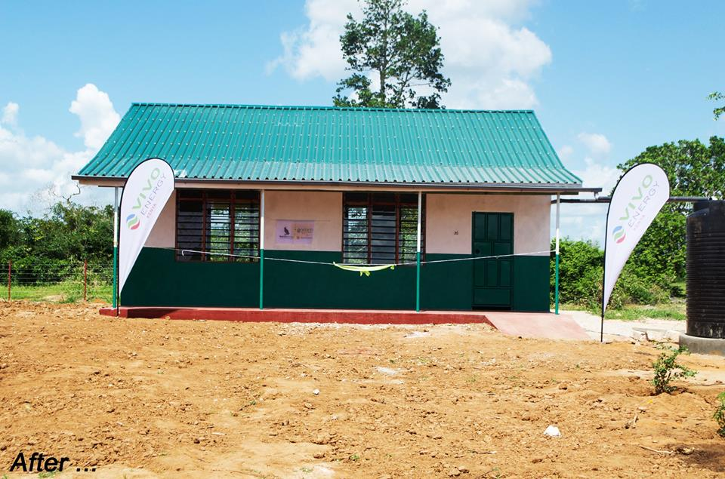
Corporate engagement & sponsorship
Vivo Energy sponsorship
Two (2) environmental awareness events held in Dakatcha Woodland & Kinangop plateau from Vivo Energy support:
Over 800 community members and school children participated
1 Class room constructed in Dakatcha woodlands

Slide 35
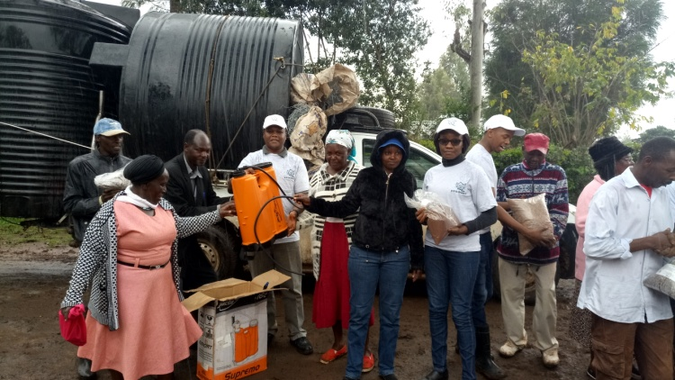
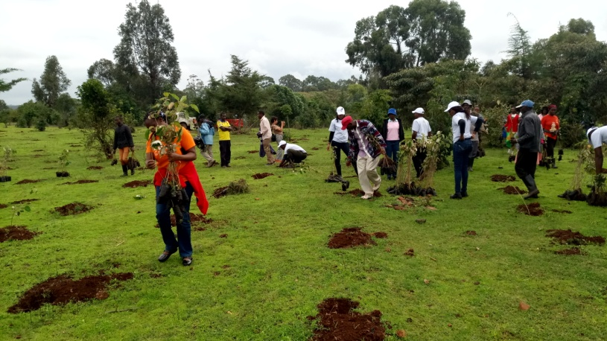
Corporate engagement & sponsorship cont…
5 CFAs and 1 SSG issued with the tree nursery implements and assorted tree seeds from KBL/EABL support
47,000 forest tree seedling planted in Mt Kenya forest
50 KBL/EABL staff and over 230 local communities participated in tree planting in Mt. Kenya forest

Slide 36
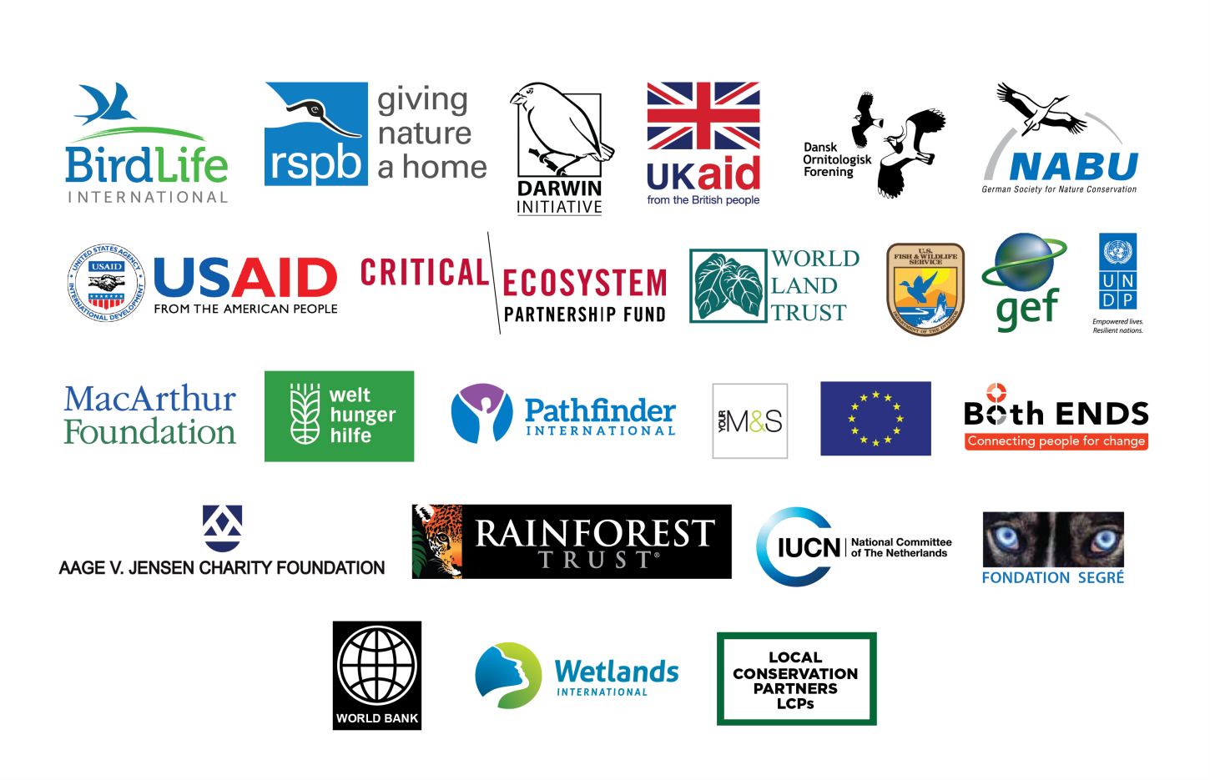
FUNDING & SUPPORT
BirdLife partnership
Nature Kenya’s fundraising capacity enhanced
Project funders diversified
31 corporate members engaged
RSPB core development support
Efficient programme delivery and donor reporting

Slide 37
THANK YOU to the Board, staff, members and partners

